Slide 1
PPM PD Lecture 2: Recruitment and Selection
Aims of the session:
Start thinking like a recruiter before you make your own job/placement applications

Slide 2
Points to consider
The advice in this presentation comes from UK based career advisors and recruiters
There is no one universal way of writing a successful CV
Writing CVs is industry and culture specific
Ultimately, you will need to decide how you want to sell yourself to the employers/recruiters
This presentation gives you suggestions but there are no hard and fast rules
Spend enough time researching before you write your own CV
Bear in mind that in some cases the advice may be more relevant to more experienced employees, not young students

Slide 3

A new job is advertised = the company has a problem Vevox app 179-837-441
Job needs to be done and the company needs to find somebody appropriate
Will the applicant have the knowledge, skills, experience to do the job?
Will they have the right attitude? Bright, intelligent and lazy????
Will they get on well with the team?
Will they be flexible, want to learn new things and accept feedback?
How will they react to change?
Will they fit in the company?
Are they committed to stay in the job?
What value will they bring to the company?
.
Recruitment is an expensive process that involves risk.
Notes:
https://www.youtube.com/watch?v=VDFgGi-lrD0

Slide 4

Recruitment is an expensive process for the company,
Recruiters are shamed on Twitter if they get it wrong,
Recruiters need to tick boxes (there is lots of red tape involved)
Nobody wants to hire a problem, it’s about showing your relevance and reducing the risks,
Recruiters want to prove that they are good at their job “I spotted this person, I hired them, you can trust my judgement”
However, not everything is always perfect….

Slide 5

CIPD Research
CIPD (The Chartered Institute of Personnel and Development) research suggests that post Covid work is becoming less central to our lives. Going above and beyond is no longer seen as a duty in exchange for a salary.
In 2024 with half of the sample population feeling the work is simply for the money.
People are identifying less with their organisation and see work as less central. It is possible that their levels of engagement, commitment, motivation all those things could also slip.
Employers know that
more engaged and more motivated staff are more likely to perform better, be more satisfied and less likely to want to leave their jobs

Slide 6

It's up to employers how they recruit for their organisation
There are no set processes that are required by law.
But employers must follow a fair process and certain laws that apply throughout the whole recruitment process, including:
discrimination
data protection

Slide 7
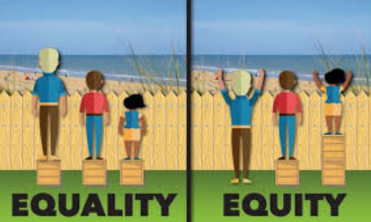
Employers should also follow good practice and any policies their organisation might have on:
recruitment
equality, diversity and inclusion

Slide 8
Scenario 1
You are an HR Manager overseeing recruitment for a role in a tech firm. One hiring manager insists that the new hire must be “young and dynamic” to match the team culture.
What is the MOST appropriate HR response in line with UK employment law?
A) Agree, as cultural fit is critical in high-performance teams B) Suggest alternative wording, avoiding age-related terms that may breach the Equality Act 2010 C) Proceed but ensure the interview panel includes older staff for balance D) Include the phrase in the person specification to attract the right type of candidate

Slide 9
Scenario 2
An organisation is using AI-based software to shortlist candidates. During an audit, it is found that the software consistently ranks candidates with foreign names lower.
Which legal or ethical issue is MOST relevant here?
A) Data retention B) Lack of a structured interview format C) Indirect discrimination under the Equality Act 2010 D) Breach of GDPR consent

Slide 10

Deciding who's involved in selecting and interviewing
It's a good idea for the staff involved in selecting and interviewing applicants to:
come from a diverse range of backgrounds
use a consistent decision-making process, such as a scoring system
Ideally 2 or more people should be involved in choosing who to interview to reduce the risk of personal biases or unintended discrimination.

Slide 11
Defining the Skills and Competencies that matter
What technical skills are essential (e.g., coding proficiency, data analysis, project management)?
Which core competencies matter most (e.g., problem-solving, adaptability, leadership)?
What values and cultural traits does the company prioritise (e.g., collaboration, accountability, innovation)?

Slide 12
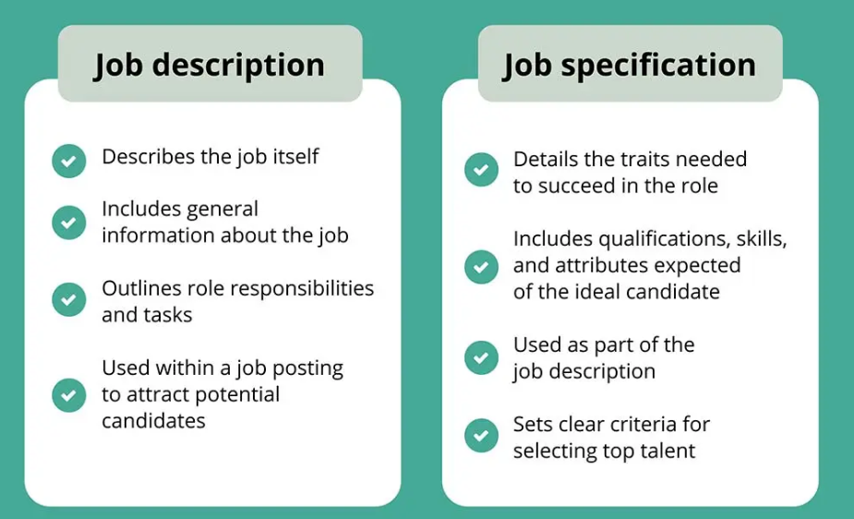
Job description/person specification
Notes:
Source: https://www.testgorilla.com/blog/job-specification-vs-job-description/

Slide 13
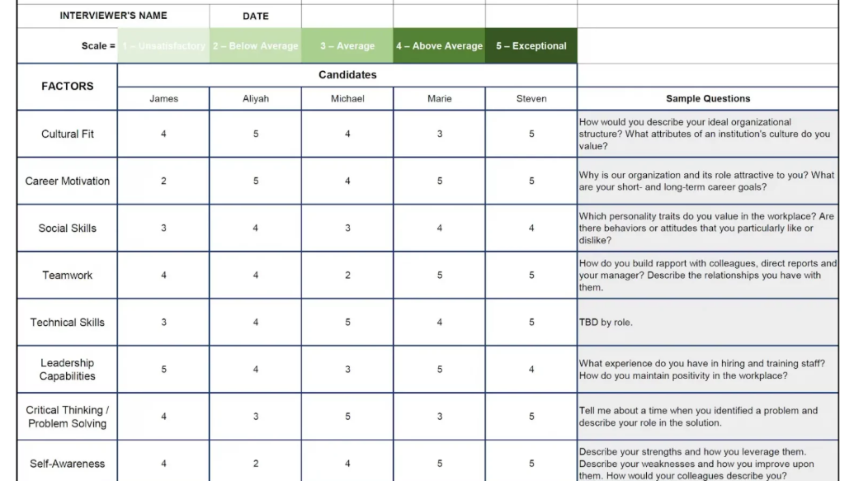
Notes:
Source: https://boulosolutions.com/hiring-rubric-what-is-it-and-how-to-create-one/

Slide 14
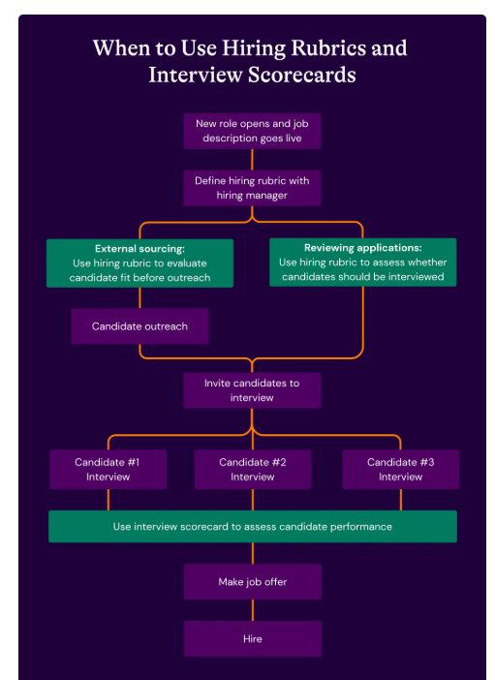
Source: https://www.seekout.com/blog/interview-scorecard-vs-hiring-rubric

Slide 15

Social Media
Companies should avoid using information that's on someone's personal social media profile, for example Facebook, Twitter or Instagram, to decide whether you interview or hire them.
The company might be breaking the law, particularly if either of the following points apply:
The candidate did not agree to you using the information in this way
The company looked at some applicants' social media profiles, but not others

Slide 16

Using information on jobs and business networking sites
When recruiting, you can usually use information that someone puts on a job website, or a business and employment social networking site such as LinkedIn.
When posting information on these sites, users will be aware that the purpose is to show their work experience and professionalism.
You must still make sure that you use this information in a way that does not discriminate.

Slide 17

The aim of the CV
Is to be offered a job interview

Slide 18
The purpose of your CV is to…
Provide recruiters with an insight into your education, knowledge, skills and experience
Make them curious to meet you in person and learn more about you
Make them believe you may be the answer to their problem (there is a job to be done and no person to do)
Show/demonstrate you know about their company, sector, industry

Slide 19

Recruiters’ point of view
Can I defend my recruitment decision to my boss if I am challenged?
Who is reading the cv? Recruiter/line manager? Can the applicant do the job? If not, who is going to deal with it?
Will this person be a liability and cause problems?
The first step is to sift through the pile of CVs (funnel idea)
Reasons to reject (no, yes, maybe)
yes/maybe CVs will be read more carefully
Notes:
Photo source: https://www.altamirahrm.com/en/blog/recruiting-funnel

Slide 20
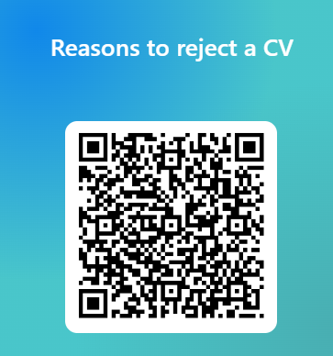
Quiz

Slide 21
A recruiter giving feedback on a CV
https://www.youtube.com/watch?v=VDFgGi-lrD0

Slide 22

Reasons to reject a CV
Lack of skills, knowledge
Lack of experience
Generic, “empty” statements, not substantiated with appropriate evidence
Inappropriate format (spelling mistakes, lack of reference number, wrong company details)
Generic CV, not tailor made to the specific job description
A bad attitude coming from a CV (e.g. applicant coming across as overconfident or underconfident)

Slide 23
https://www.youtube.com/watch?v=VDFgGi-lrD0

Slide 24

Never assume recruiters will read more than the front page
Notes:
Photo source: https://www.bristolpost.co.uk/news/bristol-news/should-you-follow-up-your-8568

Slide 25




Show you’ve done your homework: There is no such thing as a good general CV, you should always angle it to a specific job, placement, company, sector
Good problem-solving skills
Notes:
https://studyinfocentre.com/blog/india/career/how-to-become-plant-manager
https://www.fksg.org/dealing-with-conflict/

Slide 26
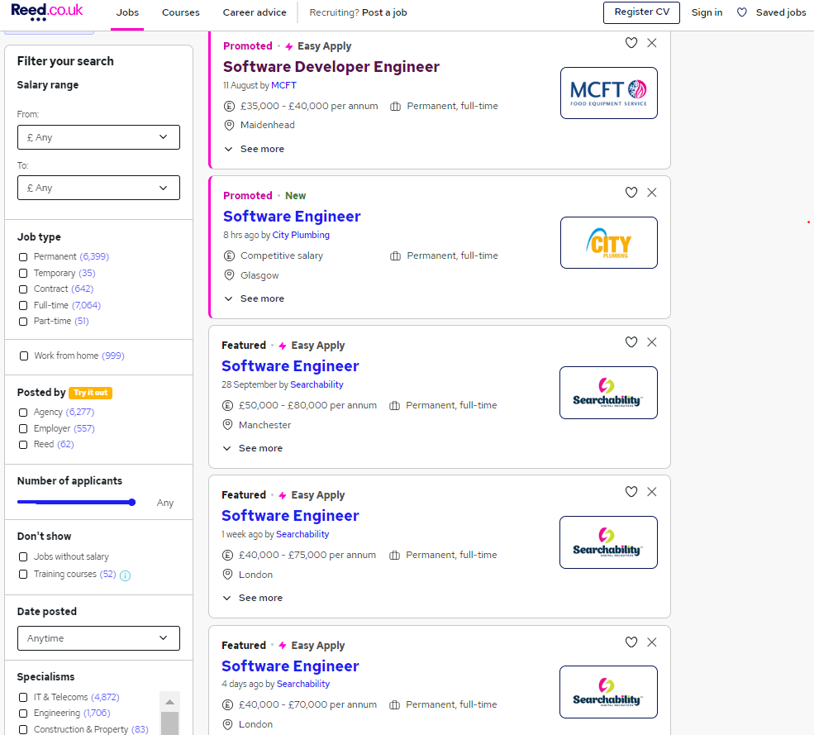
Look at the key words in the job description/person specification and match them to your profile/what you can offer

Slide 27
Give the impression that you know the job, company/industry/sector (e.g. by using the right terminology). You will stand out as a job hunter if you show you’ve done research and targeted your message.
Don’t send your CV all over the place, concentrate more on the jobs you really would like to get
A list of duties tells you nothing whether you did it successfully, whether you were good and what impact it had on an organisation and profitability
Talk about your achievements and what (and how) you did to make a difference to the organisation

Slide 28
Don’t lie or exaggerate on your CV (people do check out, instant dismissal, you can spot it in your interview)
Don’t underrepresent yourself! Don’t be boastful but also not shy.

Slide 29

Thank you for your attention

Slide 30
3 dimensions of a good CV:
1. CV Layout (Looks professional, neat and tidy)
2. CV Targeting (It’s aligned to the job the company is advertising)
3. CV Content (You are fulfilling the requirements, “tick all the boxes”, you provide evidence and convince me you are a suitable candidate for the job)

Slide 31
It takes less than a minute to read a CV…
All the action should be on the front page
You should have your best experience on the front page

Slide 32
Skills lists. How effective are they?
Excellent project management skills
Flexibility and adaptability
Word processing, data entry and spreadsheets
Web design
Leadership
Computer Software knowledge
Confident using SQL
Internet Security knowledge
Teamwork and leadership
Exceptional time management and organisation
C++ and Python.
Numeracy
Mere skills lists don’t have such a big impact, your CV needs to be embedded in the skills required by the company
Digital, technical, laboratory skills are OK as a list but team working, negotiation, leadership, time management, etc. as a list has very little impact

Slide 33
Make sure you:
You meet the job requirements
Prove you know the job, company, industry, sector
You know what they need and you are the answer to their problem (by having the right skills to do the job)
You evidence your skills, experience
You demonstrate you have a career path

Slide 34
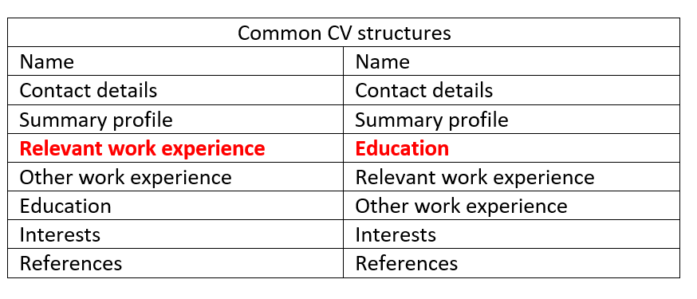
Relevance is the key, not chronological order.

Slide 35
Things to consider
Where are my strengths? What do I want to highlight?
Do you want to highlight that you have the relevant qualifications in which case qualifications come first, or work experience, in which case it comes first.
You give those most space and prominence.
Your aim is to make a good impression.
Don’t draw their attention to unfavourable things (e.g. low grades)

Slide 36
CV Layout
Has to look professional and has to have no spelling or formatting mistakes
Should be no more than 2 pages long, but don’t assume they will read the second page.
Boxes, tables, graphic might be distracting (especially if a machine does the first step of recruitment)
Ask yourself the question: Is it easy to find the most important sections, am I properly emphasising the right things?
Use the right key words for the recruiters (or the machine) to find
Bullet points are more recommended that full sentences
Recruiters scan a CV, they don’t read it.

Slide 37
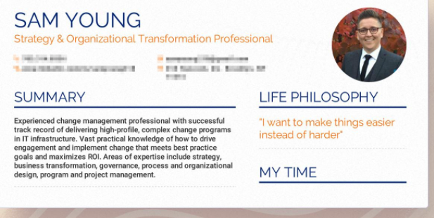
Career summary/profile

Slide 38
Career Summary
Summary 1
Summary 2
An enthusiastic IT student interested in graphics looking for a placement opportunity. A great team player with leadership skills.
Bilingual BSc Computer Science Student with 2 years of web design experience.

Slide 39
Career summary/profile
Usually it’s not compulsory and it’s very subjective so it’s hard to know what recruiters will find appealing. But there are some suggestions from the recruiters:
It mustn’t be a waffly, vague, wordy description.
Don’t make it too general (that can be a weakness).
Think about what is distinctive about you e.g. a great team player- anybody can claim that and it doesn’t differentiate you from other candidates.
Highlight your technical skills.
Give concrete things: you study this, worked in that region, have specialised expertise in this technical area of work,
NO MORE THAN 3 LINES
Is every word working for you? Give facts, not claims,

Slide 40
Other advice how to write a good profile
Keep is succinct, specific and relevant to the job
Highlight your skills and experience
Avoid overgeneralisations like a great team player
Use it to grab the recruiter’s attention e.g.
A computer science student with 10-month experience in cyber security in the UK and China and an avid designer with a track record of creating 10 internet websites.

Slide 41
Work experience
Relevance is more important than chronological order
Nobody requires students to have a full-time job but engagement in relevant activities is expected (volunteering, work shadowing, short term projects, university student projects, conferences, placements, etc.).
Avoid gaps if possible. If you have a gap then try to fill it in somehow (e.g. by engaging in your community, volunteering, doing a course, etc.)
Label it e.g. Cyber Security Experience/Marketing/Sales Experience/Other work experience

Slide 42
Include other activities such as volunteering, projects, placements, student union activities, etc.
The more evidence you can give in the specific job area, the more reassured the recruiter will be that you can do the job and that you are committed to the industry.

Slide 43
Provide enough details and evidence, not just statements
Don’t list just your duties. Write what’s relevant to the job, what impact you did. Can you quantify it?
Lynx-Web designer
Designed 12 websites over the last 3 months, using the ABC technology (write details of the technology) and received over 90% satisfaction from the customers. Leading a team of 10 people, successfully negotiating 7 contracts worth approximately £25 000 and generating £10 000 of profit for the company in 2021.
Lynx-Web designer
Duties: Designing internet websites
Presenting design ideas to clients
Producing sample page layouts, known as ‘wireframing’
Receiving feedback from clients about draft sites and make any necessary adjustments
Designing the physical imagery, graphics and animations of new websites

Slide 44
Unrelated work experience
Cafes/pubs/shops/care/warehouse, etc.
Focus on transferable skills you gained in these roles
Provide evidence and tangible results of your work if possible
In your CV highlight short term projects, work shadowing, volunteering which are related to the job you are applying for.

Slide 45
Education-emphasise the course content and relevance
CV1
CV2
BSc to date, NTU, School of Computer Sciences,
BSc to date, NTU, School of Computer Sciences,
Python programming
Cyber security level 1
Advanced data analysis using excel (or name the software used)
Project: Writing an assistive technologies report based on literature research.
Skills developed
C++, Advanced Excel, HTML5,
Time management skills: Submitting on time all the coursework while being a students union member and working part-time.

Slide 46
Education
Start with the most recent qualification/degree
Include key elements of your education (not just your compulsory courses)
Make direct links to any course that is relevant to the job you are applying
Mention professional qualification exam passes
Don’t go earlier than you’re A levels

Slide 47

In summary
Think like a recruiter would
Constantly upgrade your skills, experience
Never send generic CVs to companies
Do research in your field/industry
Call HR of a company if you have questions
Make your CV easy to navigate
Use industry specific language/terminology
Highlight the relevant key words
Provide evidence, not just empty statements
Gain feedback from various professionals

